Slide 1

MILES CAR AUCTION SITE
Soltanov Nijat

Slide 2
MILES CAR AUCTION SITE
P136
Soltanov Nijat

Slide 3
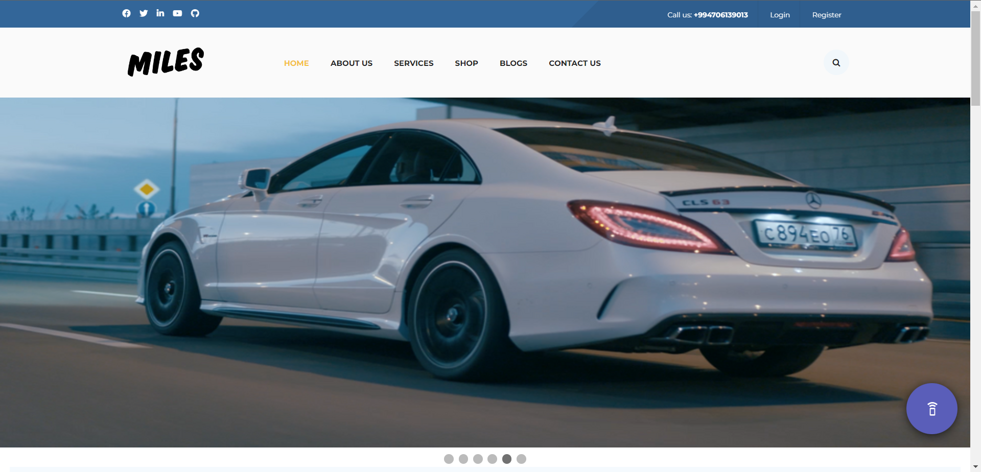
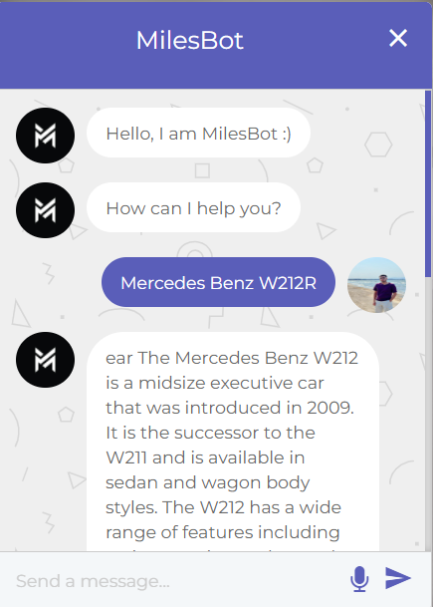
General Information About Site
Microphone

Slide 4
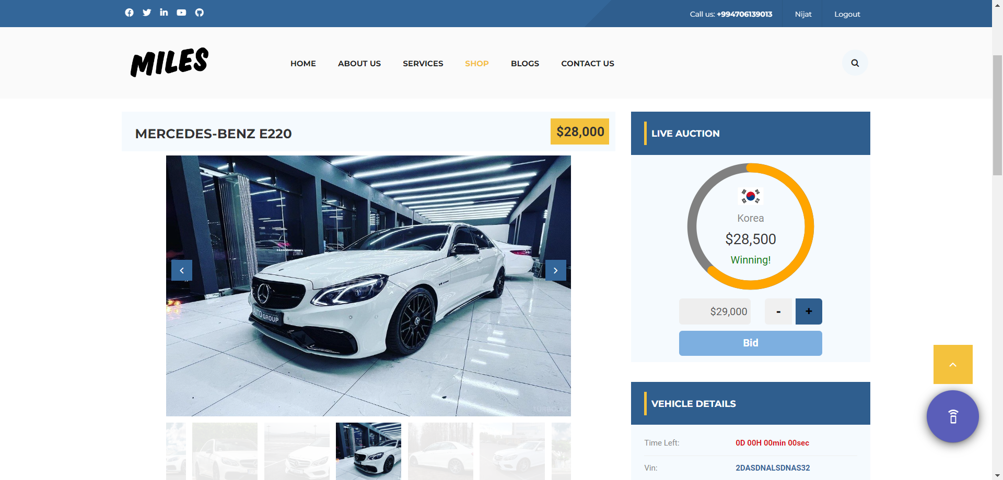
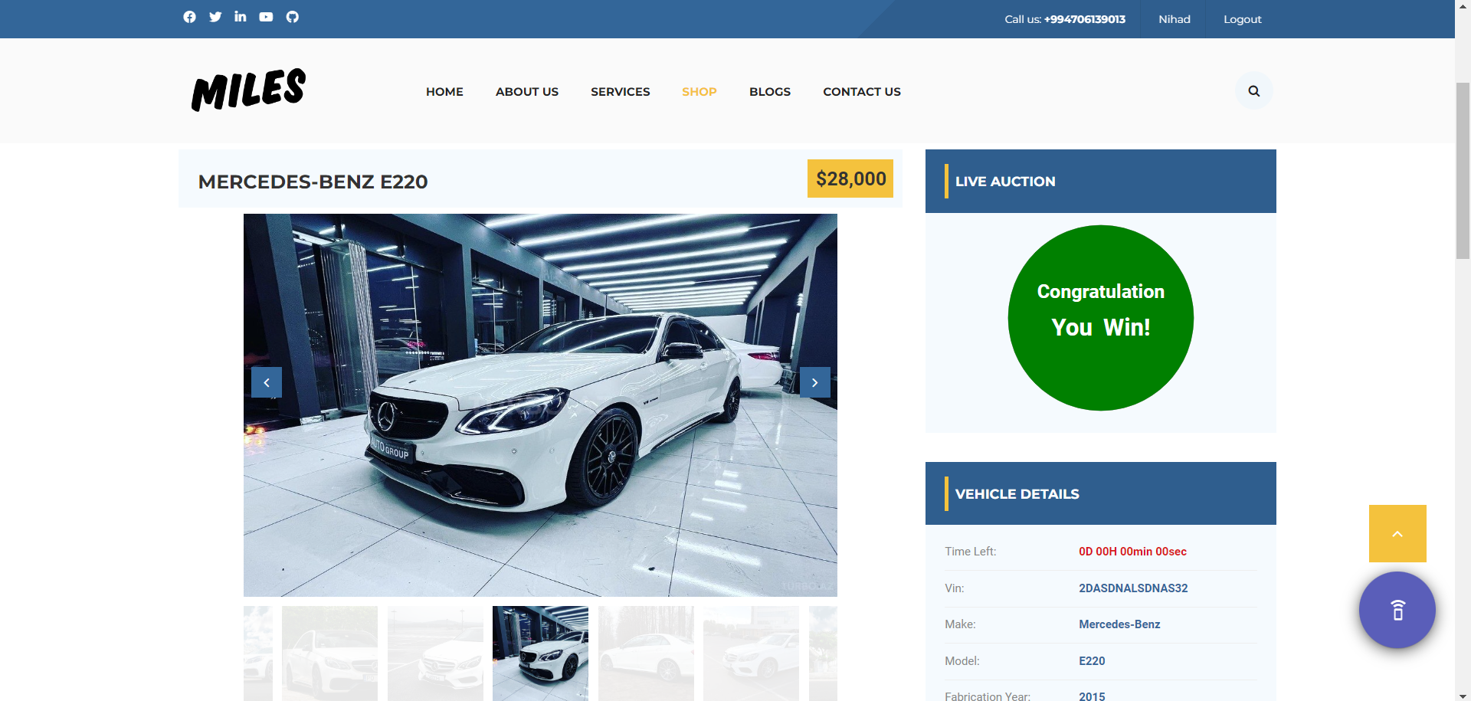
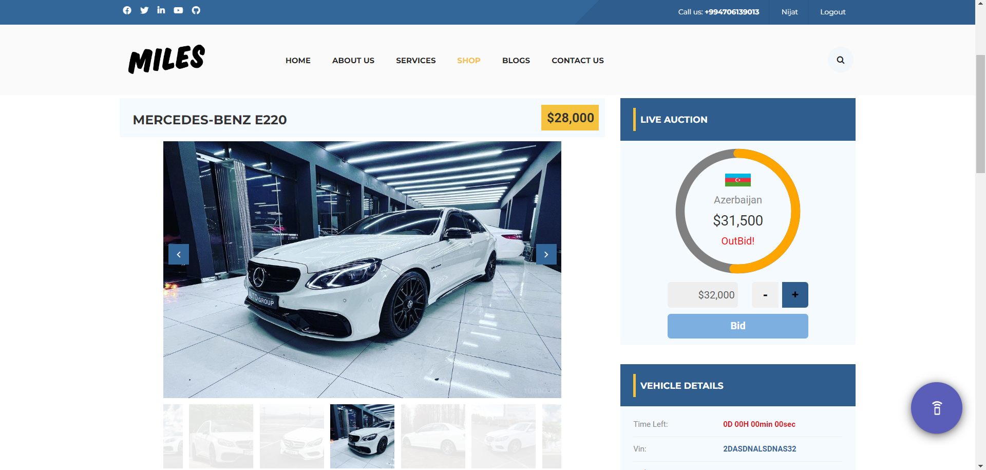
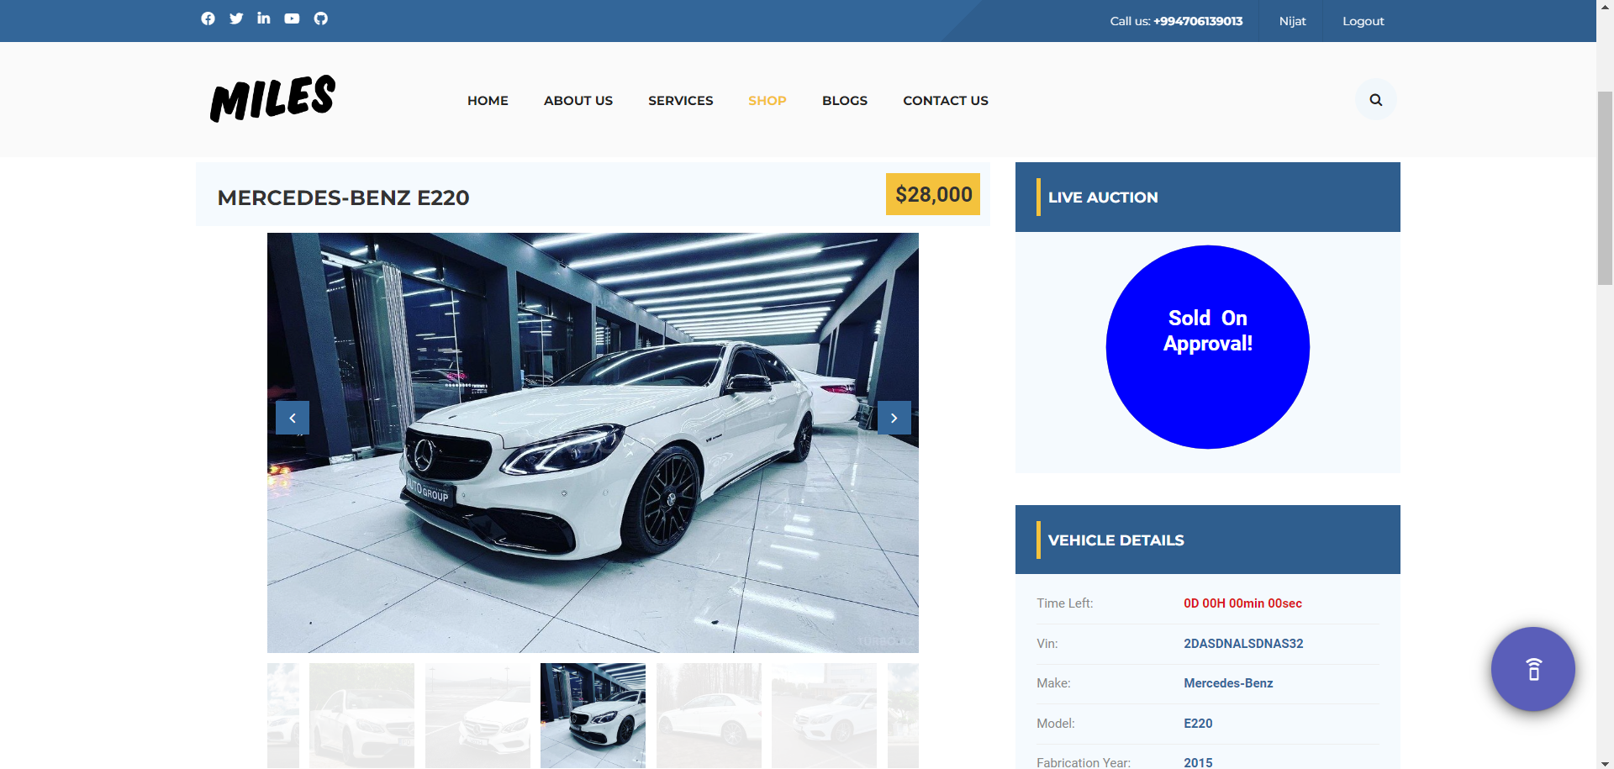

Slide 5
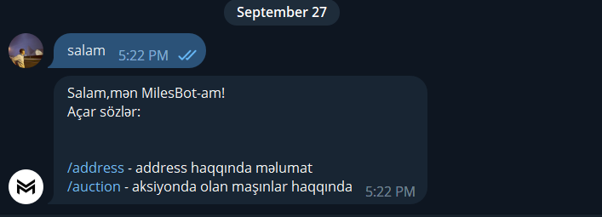
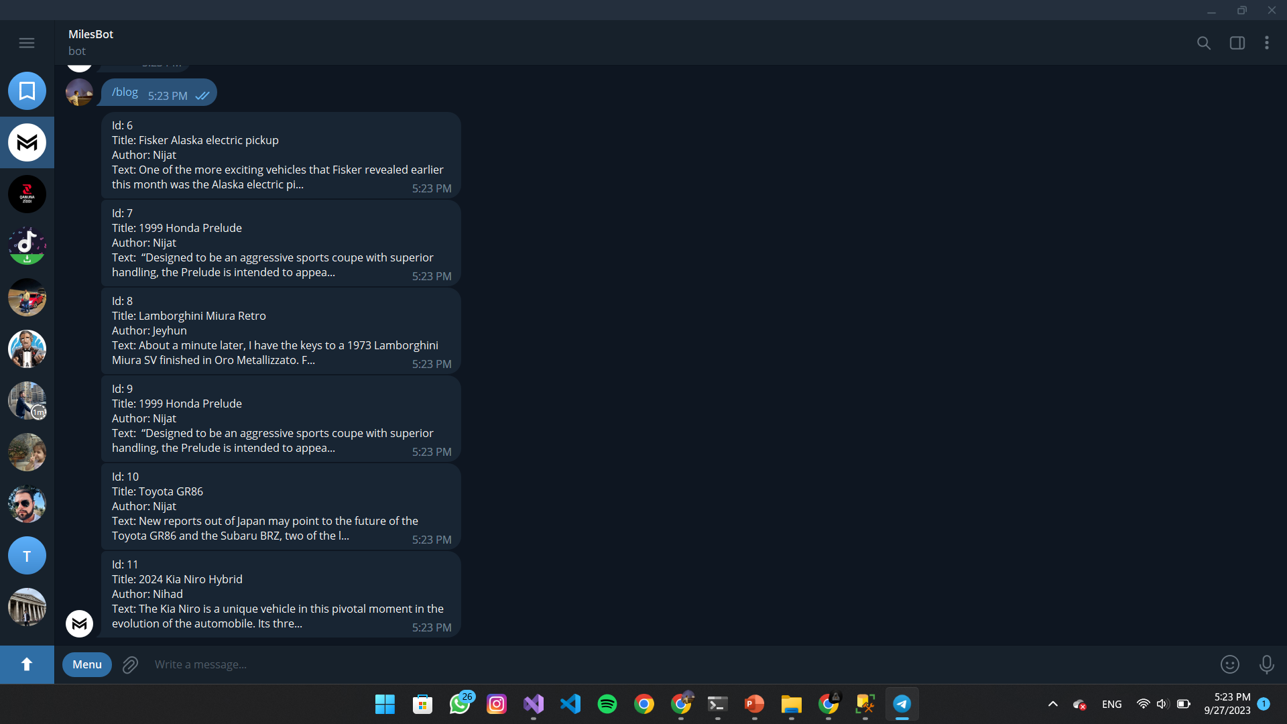
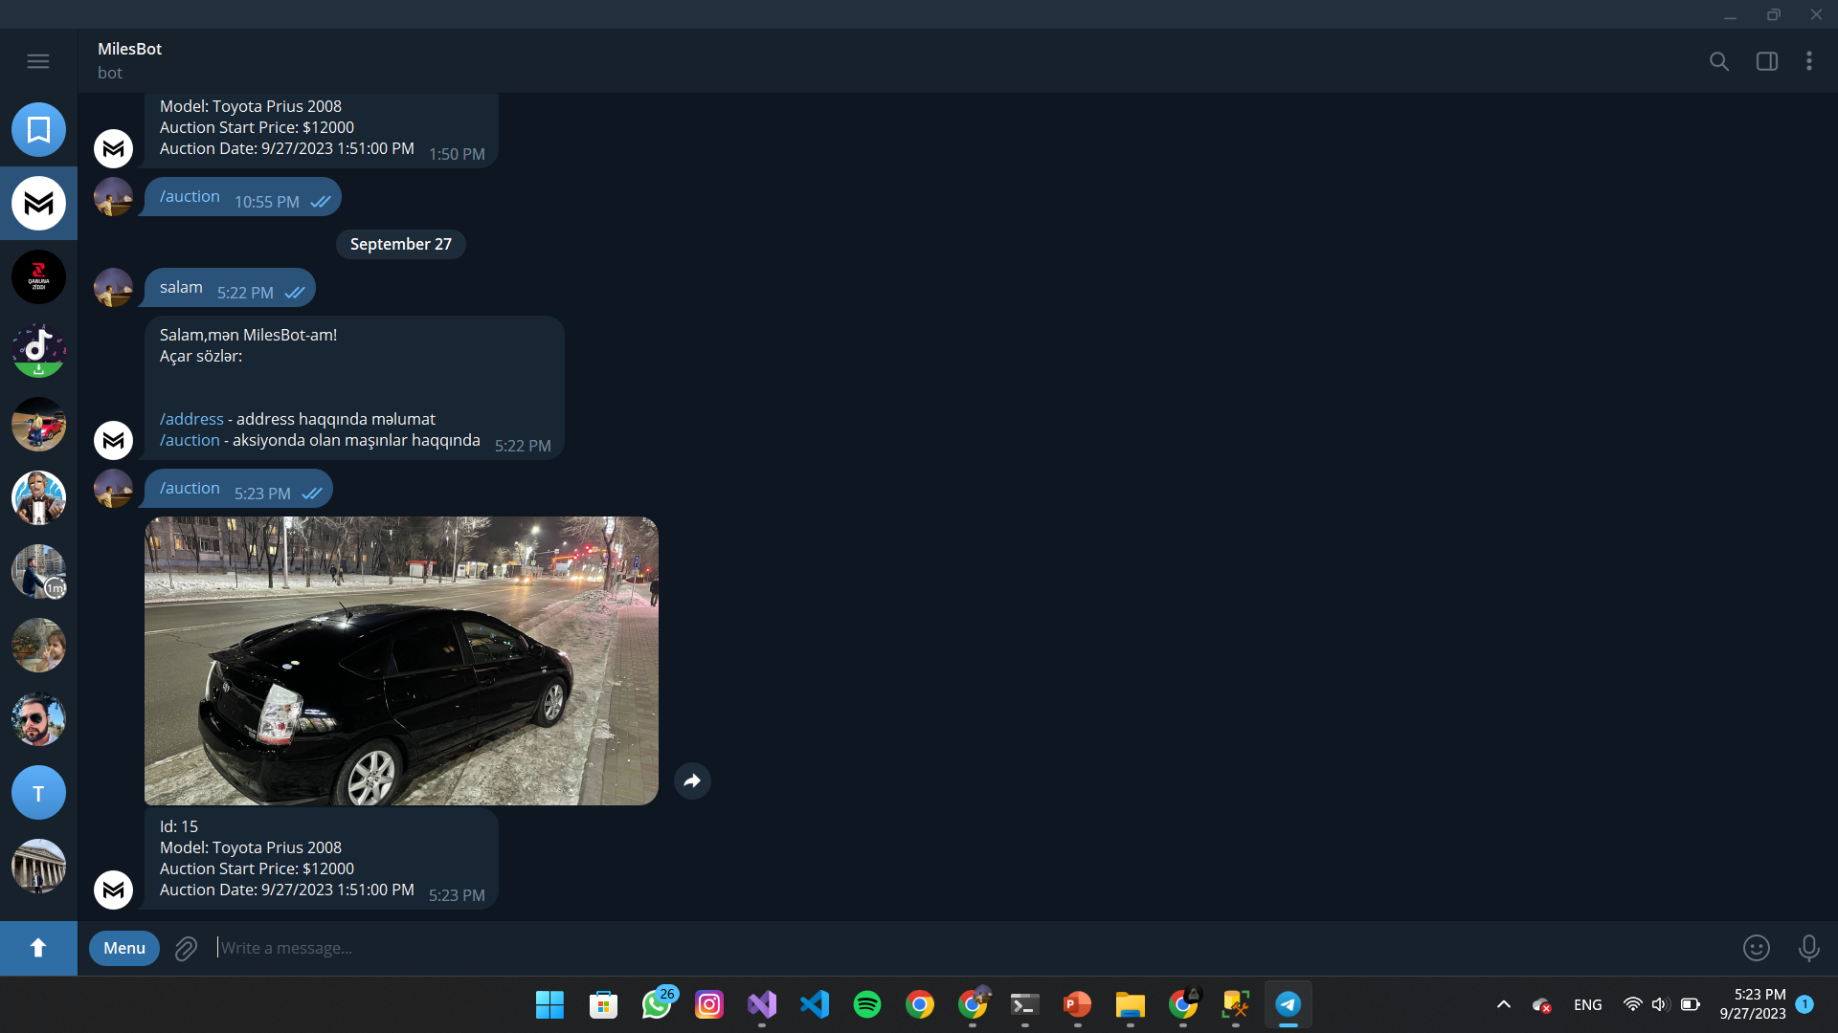
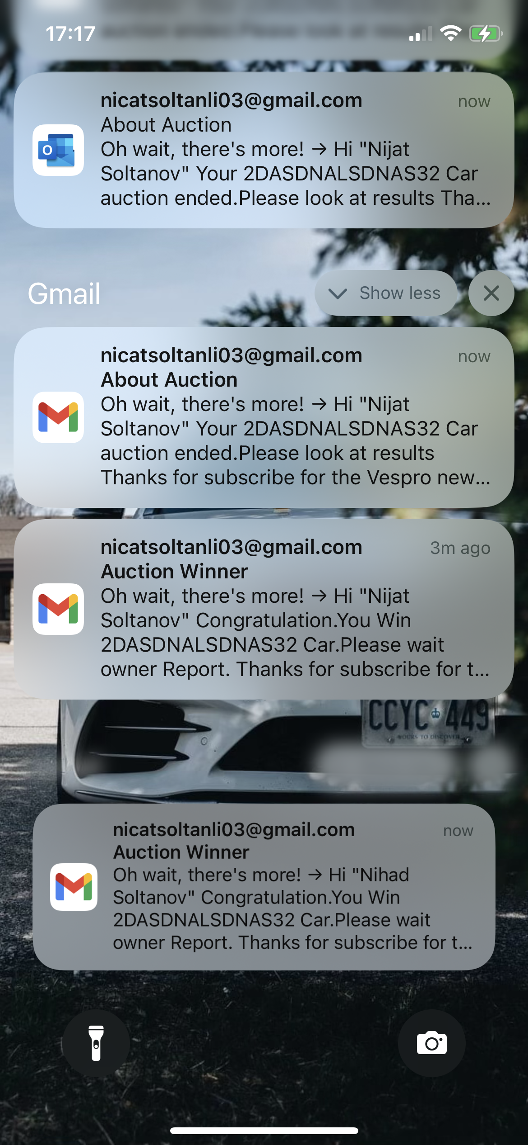
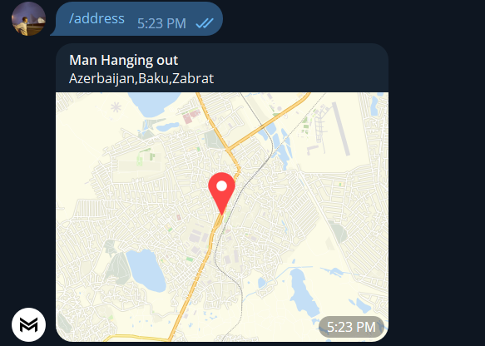
Telegram Bot

Slide 6
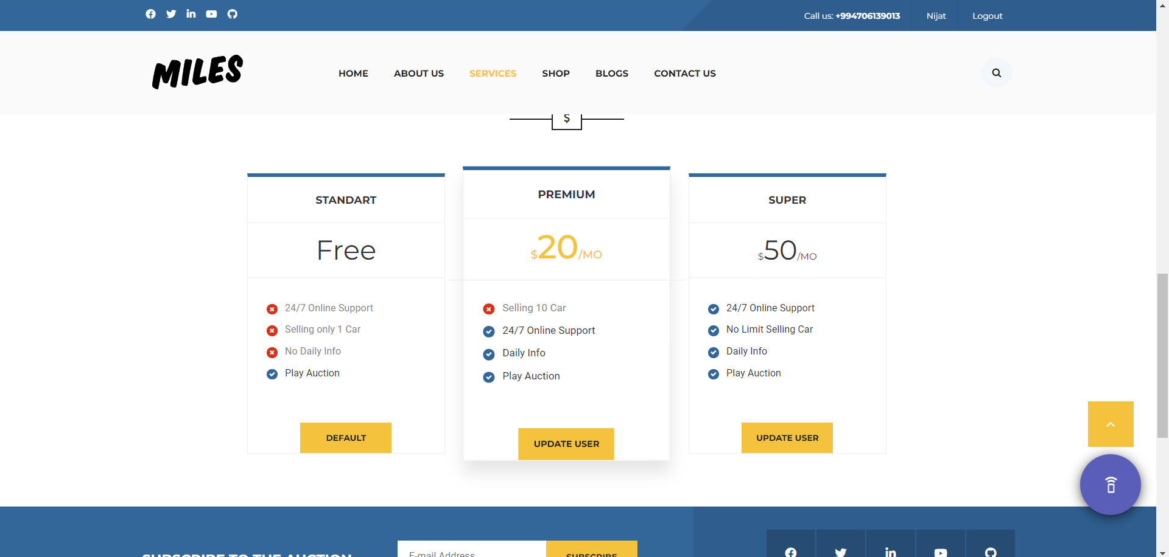
Types of Users and Features

Slide 7
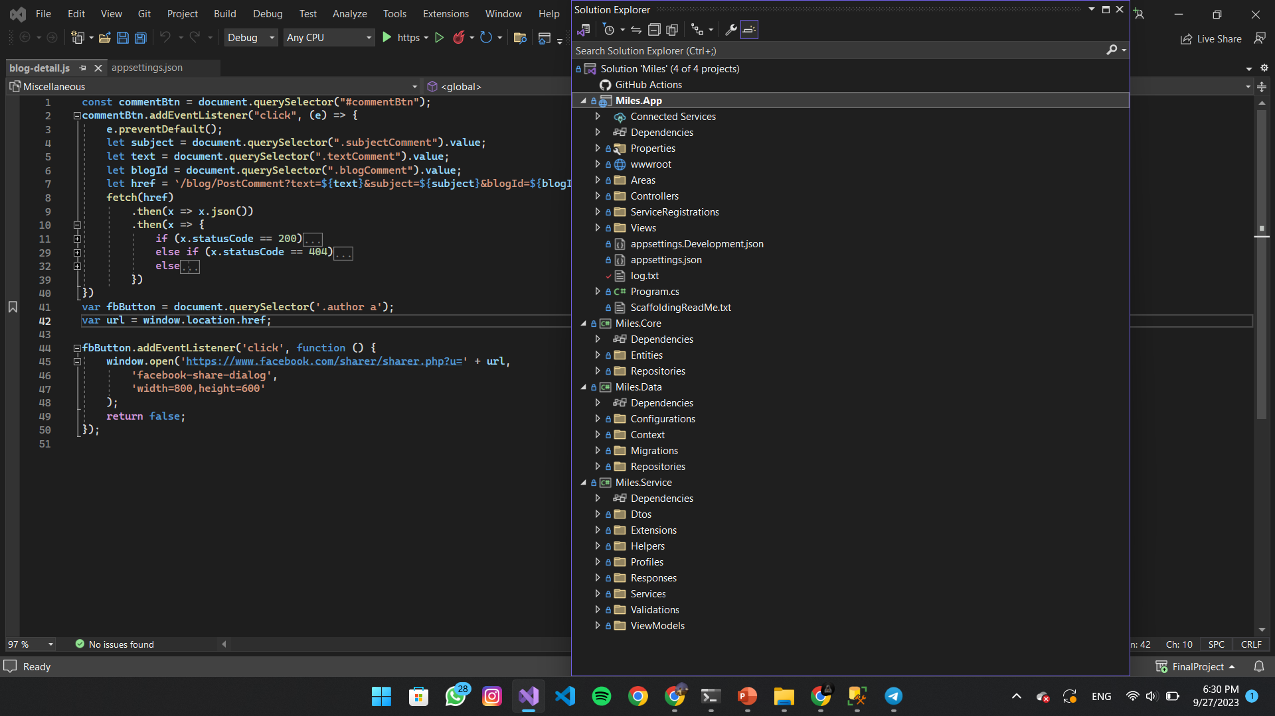
Used Technologies
Front-End | Back-End
HTML | ASP.NET Core MVC 7
SCSS (7-1 Pattern) | MSSQL
Javascript | C#
Bootstrap
jQuery

Slide 8

THANKS FOR YOUR ATTENTION!

